Slide 1
ECE Open House
Miner Elementary School

Slide 2
Miner ECE General Info
9 ECE Classes
8 General Education
1 ELS program
Looping Classes
2 adults per class
Teacher and Paraprofessional
Class Sizes
PK3 – 16 students
PK4 – 20 students
PK Mixed-Age – 17 students

Slide 3
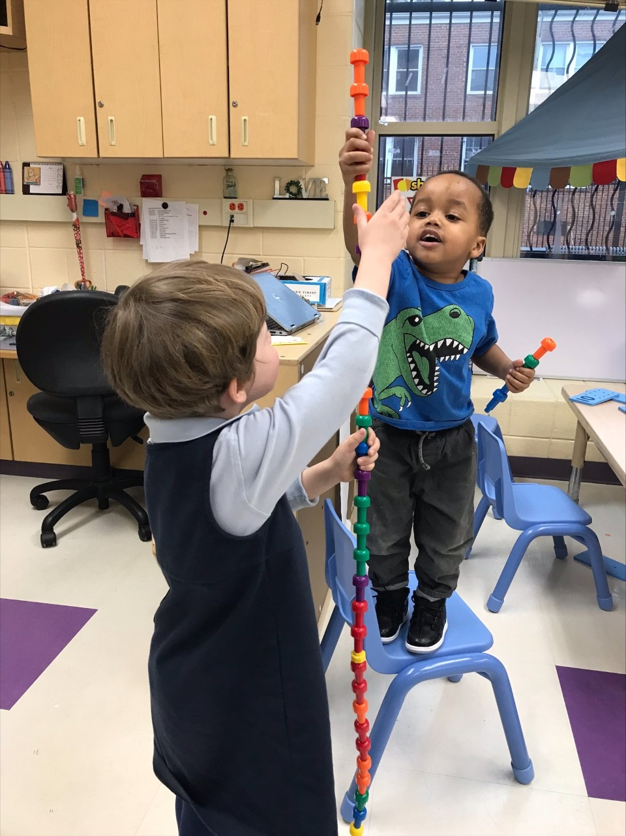
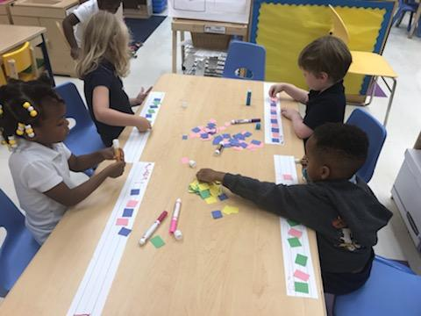
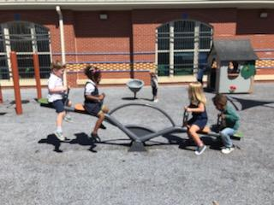
Agenda
Sign In
Welcome and Introductions
Curriculum Discussion
Classroom Management
Special Subjects
Daily Classroom Schedule
Arrival/Dismissal
Question and Answer
1/24/2024

Slide 4
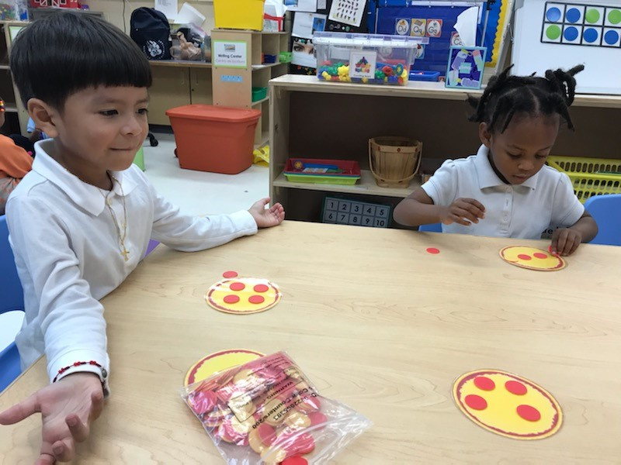
Our Curricula
Embeds mathematical learning in PreK students’ daily activities—from designated math activities to circle and story time
Relates informal math knowledge to formal concept settings
Phonemic Awareness instruction
Research and Project-Based
Emergent Curriculum
Units of study - Buildings, Recycling, Clothes, Balls, Water, Trees and more!
Centers -Dramatic Play, Blocks, Math/Toys and Games, Library/ Listening Center, Art, Discovery/ Sand and Water Table

Slide 5
Assessments
Gold Objectives
23 Objectives
6 Areas of Development
Social Emotional, Language, Cognition, Physical, Literacy, Math
Continuum
Documentation
Ongoing
Various Forms- anecdotal notes, pictures, video, recording, work samples
Ages and Stages Questionnaires (ASQs)
Required Curriculum Tasks (RCTs)
Heggerty and Building Blocks Assessments

Slide 6
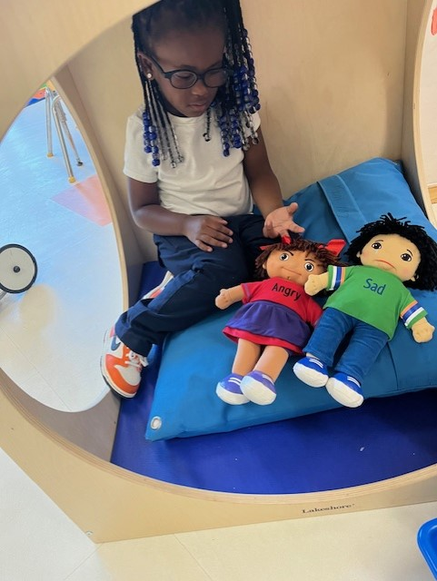
Social Emotional Learning
Relationships
“the motivation to behave comes from being in a relationship” ~Conscious Discipline
Classroom Agreements
Modeled behavior
Cool-down area
Books on Emotions
Sensory Activities
Communication folders
Messaging through Remind App

Slide 7
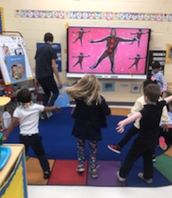
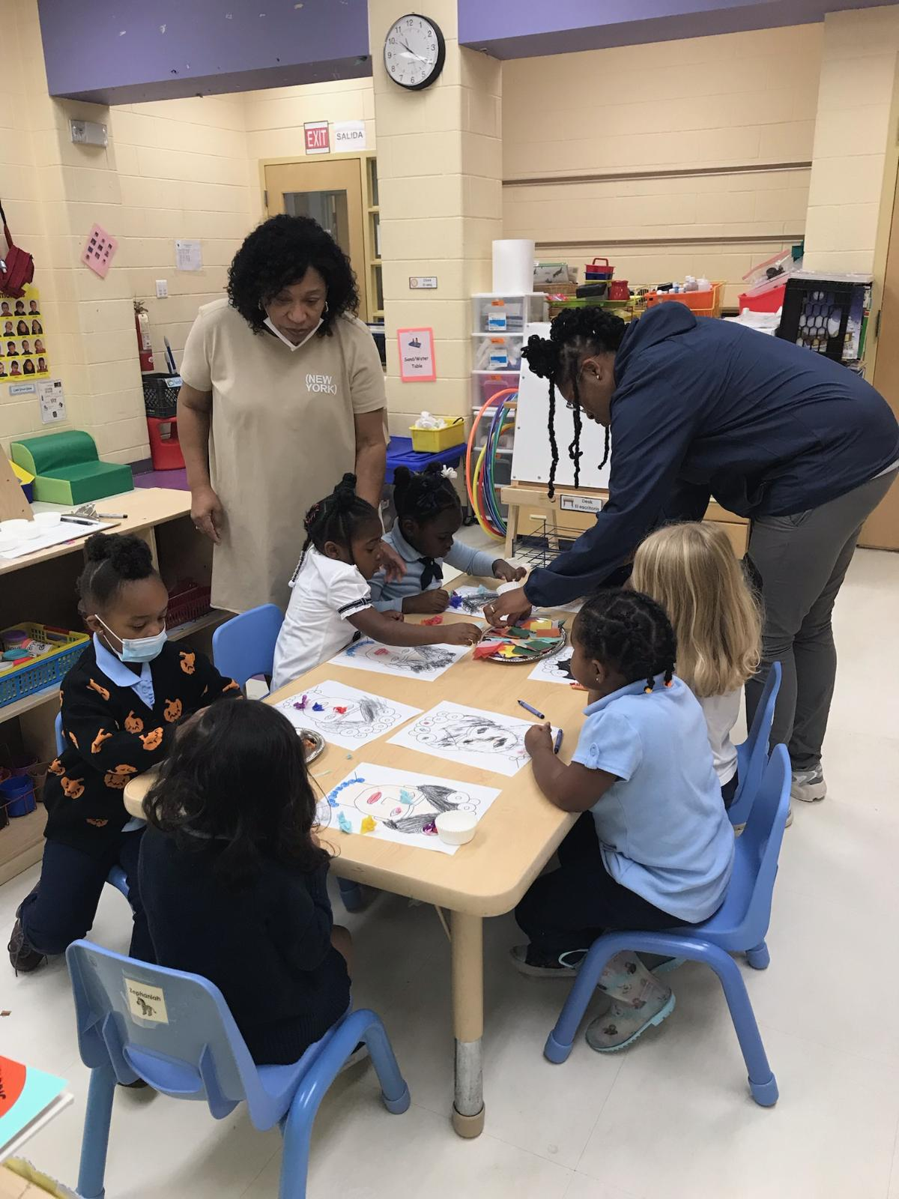
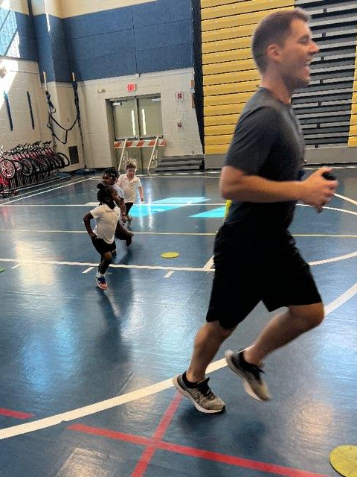
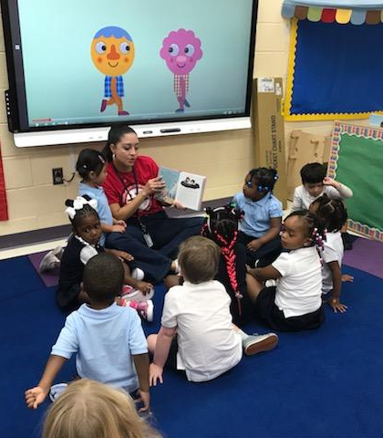
Special Subjects
45-minutes each day in the classroom (except PE)
Spanish
Music
Art
P.E. (Twice per week)

Slide 8
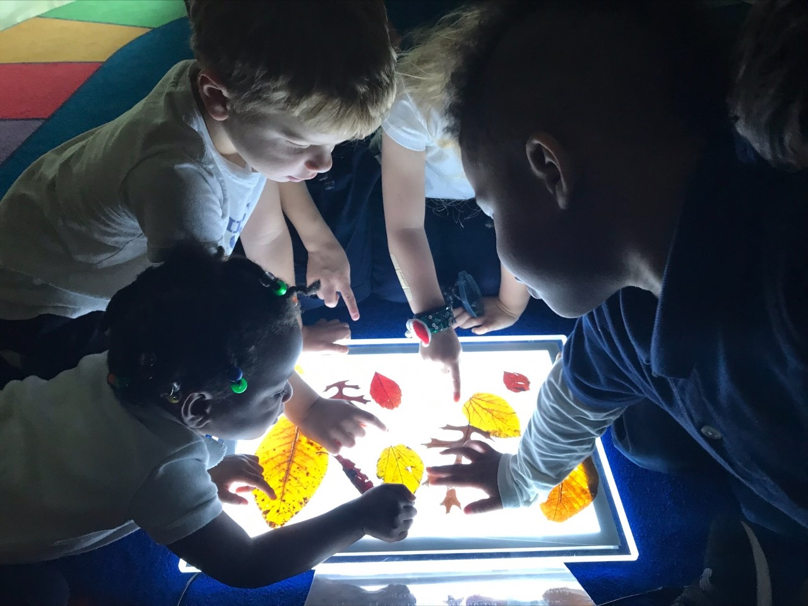
Daily Schedule
8:20AM – 8:40AM Arrival
8:40 AM – 9:00 AM Breakfast
9:05AM – 9:35AM Morning Meeting/ Building Blocks
9:35 AM – 10:20 AM Specials
10:25AM- 10:35 AM Heggerty
10:35 AM-11:35 AM Centers
11:40AM-11:55AM Read Aloud
11:55 AM- 12:15PM Recess
12:15PM- 1:00 PM Lunch/Bathroom
1:00 PM- 2:30PM Rest/Quiet Time
2:30PM- 2:55 PM Snack/Reflection
2:55PM – 3:10 PM Recess
3:10 PM – 3:15Pm Prepare for Dismissal/Dismissal

Slide 9
Arrival and Dismissal
8:20 Arrival
8:40 Teacher Pickup/Breakfast in the classroom
9:00- Attendance taken
2:45- Early dismissal ends
3:10 - Teachers prepare for dismissal
3:15 - Students are dismissed on the ECE playground
* During Inclement Weather and Staff Meeting Days, students will be released from the ECE corridor. Parents/Guardians will come to the ECE door to sign out.

Slide 10
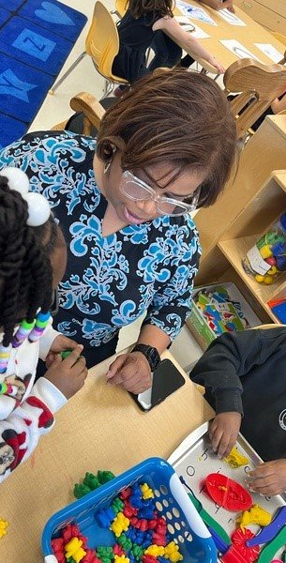
Supports for Students
Mental Health Supports
2 Full Time Social Workers
1 Full Time School Psychologists
1 part time DBH Clinician
1 Full Time MBI Clinician
Climate and Culture
Dean of Students and Behavior Technician
Community School
Full Time Community School Coordinator

Slide 11
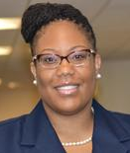
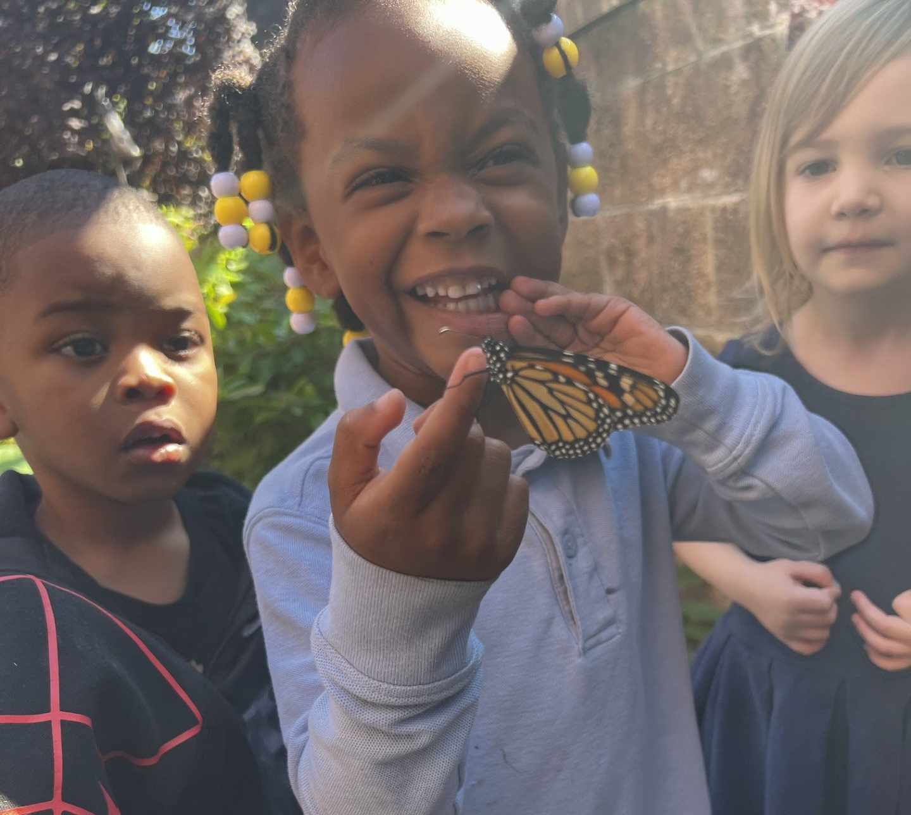
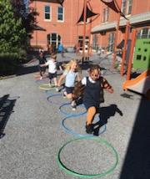
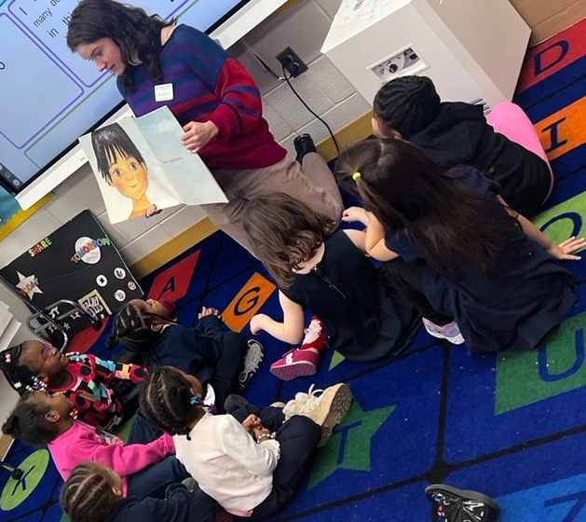
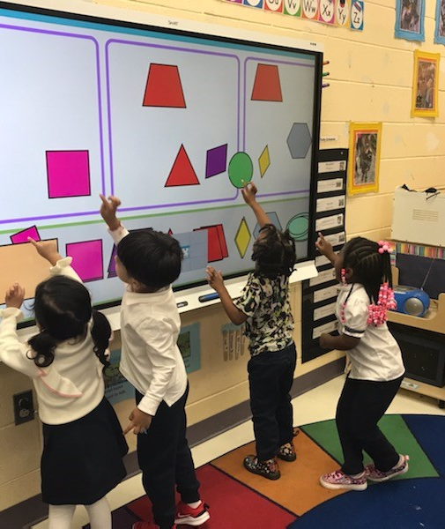
Why Miner ECE?
2nd largest ECE Program in DCPS
Special Education program - Early Stages students
All-day program
Before and after-school programs available
Community partnerships (PTO, Mutual Aid Network, Atlas, Foodprints, Christ City Church and more!)
Active Supervision Plans

Slide 12
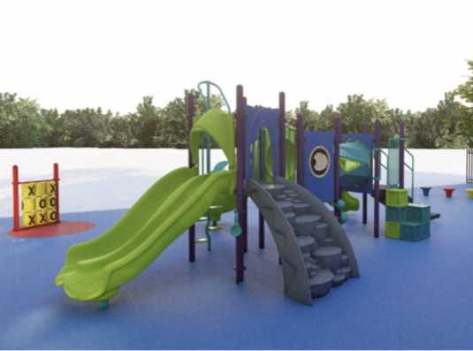
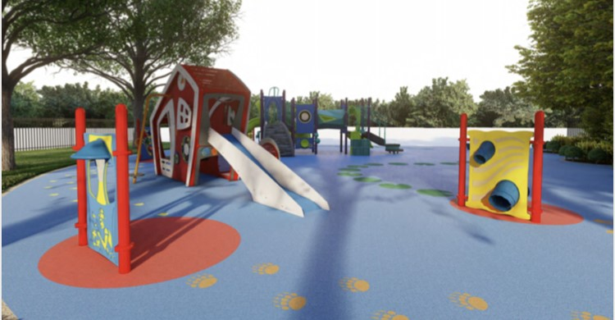
Coming in SY 24-25:
Old Miner Early Learning Center and Playground

Slide 13
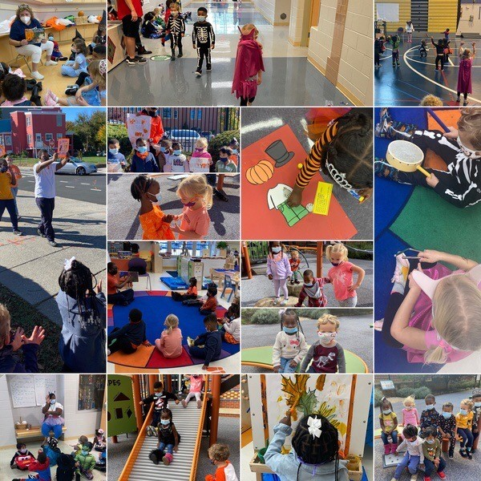
Questions and Answers

